Slide 1

Predicting Football Player Goal Scoring Using AI
Sotia Koukou & Victoras Panayiotides
Professors: Pavlos Protopapas, Ignacio Becker
Mentors: Anshika Gupta, Nawang Thinley Bhutia

Slide 2
Problem Statement
Predicting the number of goals a player, from the premier league, will score in an upcoming match..
Importance of this prediction:
Useful insight for the scouting department of the team.
Setting up the starting XI and adjust the tactics of the match.
Helps manage the team's attacking players and help the scouting team make decisions on potential transfers.
Assists fans to bet on players scoring in upcoming matches.
Notes:
1. Predicting the number of goals a player is going to score in an upcoming match is a
2. Knowing the goals that will be scored in an upcoming match by a player will help

Slide 3
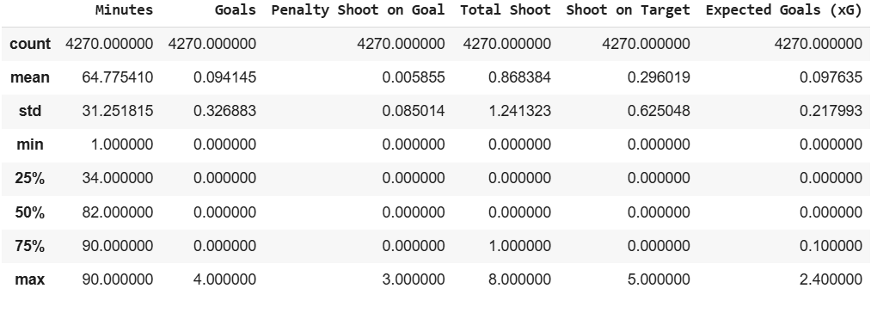
Dataset
From Kaggle (df for all players):
https://www.kaggle.com/datasets/davidcariboo/player-scores/data
Df for all players statistics:
Shape: (4270,9)
Target variable: Goals Scored
Predictors:
Player name
Team
Position
Minutes played
Total shoots
Total shoots on target
Penalty shoots on goal
Expected goals(xG)
Notes:
2nd bullet point: Also,
3rd bullet point: Moreover,
4th bullet point: Lastly,

Slide 4
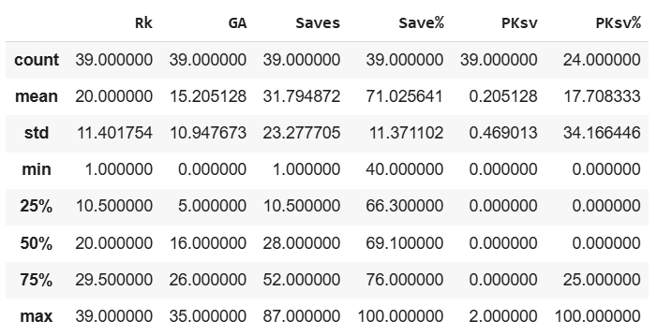
Dataset
From FBref (df for goalkeepers):
https://fbref.com/en/comps/9/keepers/Premier-League-Stats
Df for goalkeepers statistics:
Shape: (39,6)
Target variable: Goals Conceded
Predictors:
Player name
Team
Position
Saves
Penalty kick saves
Notes:
2nd bullet point: Also,
3rd bullet point: Moreover,
4th bullet point: Lastly,

Slide 5
Our approach so far:
We imported the necessary libraries needed for the program, and used panda’s attribute ‘pd.read_csv’ to upload the datasets.
We removed missing values and removed columns with many missing data using pandas attributes ‘isnull()’ and ‘.drop()’.
We visualized our data using heatmaps, scatterplots and histograms
Notes:
Pics

Slide 6
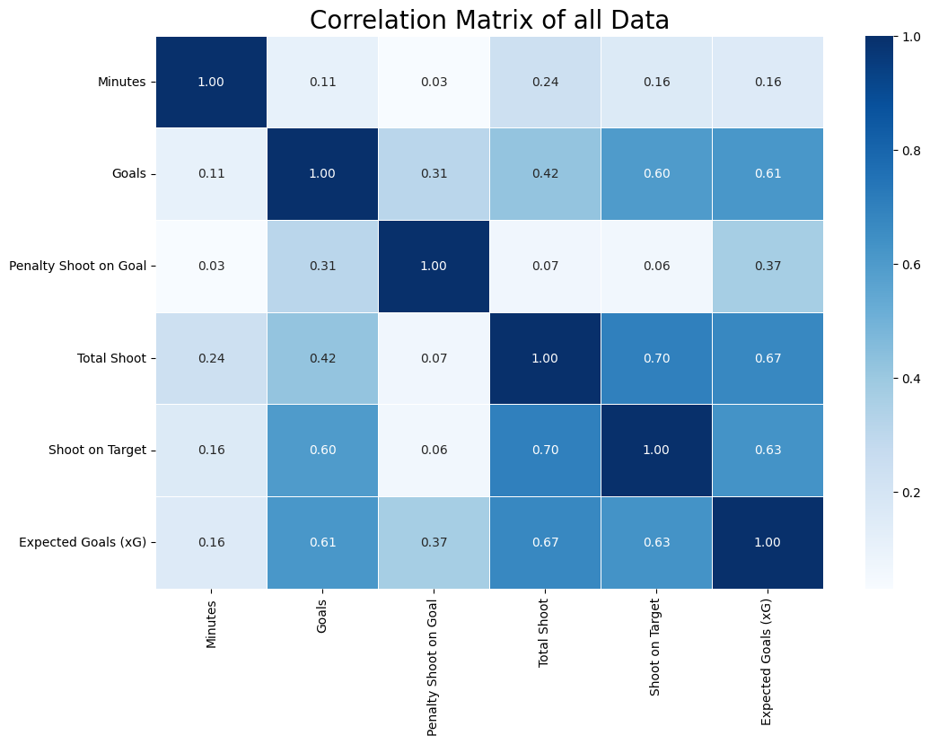
Visualizing data
We started by plotting a correlation heatmap to investigate the correlation between all of our predictors.
.
.
.
Notes:
Pics

Slide 7
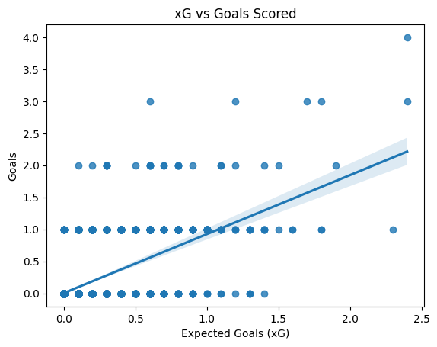
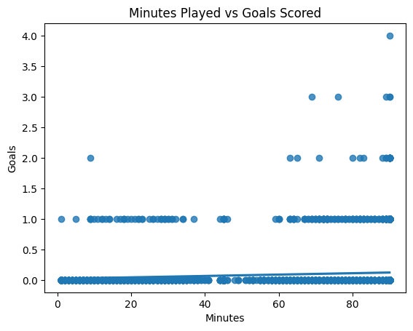
Plotting data
Then we plotted Scatterplots with regression lines to examine the relationships of the predictors with the response variable.
.
.
.
Notes:
Pics

Slide 8
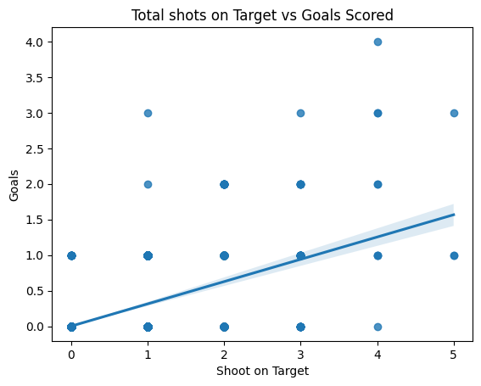
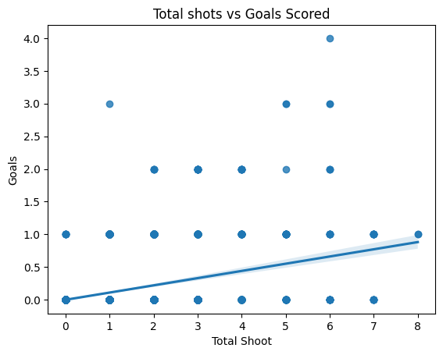
Plotting data
Then we plotted Scatterplots with regression lines to examine the relationships of the predictors with the response variable.
.
.
.
Notes:
Pics

Slide 9
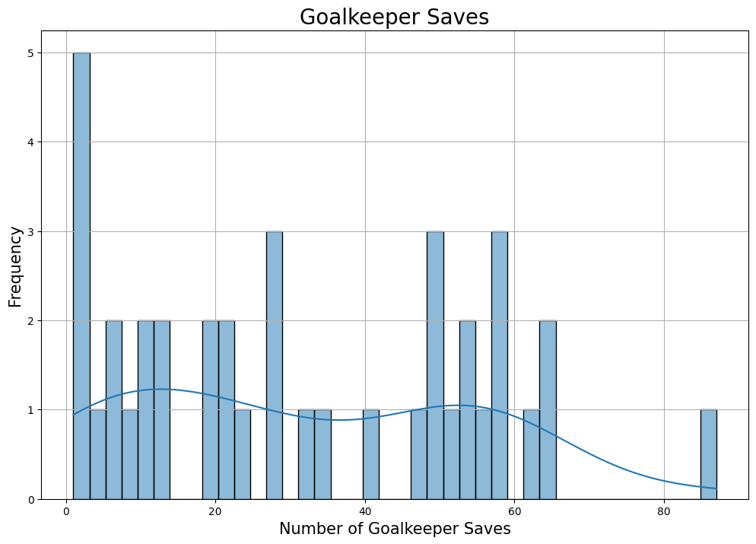
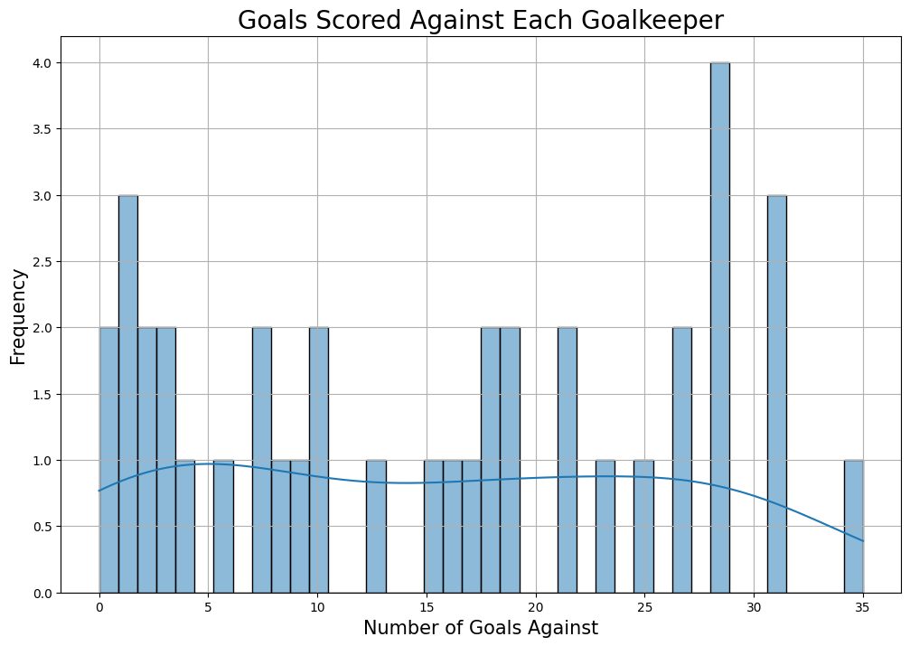
Visualizing data
Lastly, we plotted some histograms to show the distribution of variables.
.
.
.
Notes:
Pics

Slide 10
How are we going to solve the problem?
We will split our data into Training, Testing and Validation to ensure proper model evaluation.
We are planning on using different models we believe suit our data like multilinear or polynomial regression.
To prevent overfitting, we will apply regularization techniques like lasso and ridge regression.
If necessary, we will also use cross-validation to ensure our model performs well on unseen data.

Slide 11
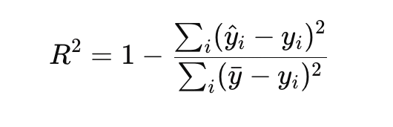
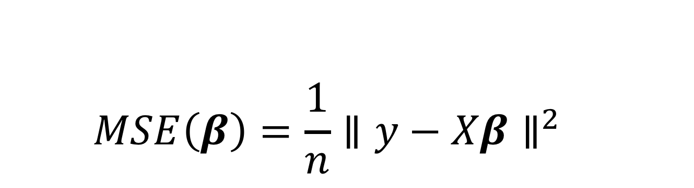
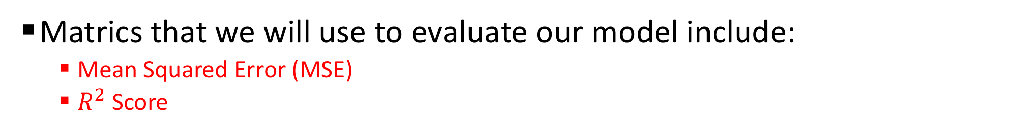
Model Evaluation
Matrics that we will use to evaluate our model include:
Mean Squared Error (MSE)
$R^{2}$ Score
$$MSE\left(β\right)=\frac{1}{n}{∥y−Xβ∥}^{2}$$

Slide 12
Conclusion:
We will use machine learning techniques to create the most accurate model we can.
To predict the number of goals a premier league player will score in an upcoming match.
We will experiment with different algorithms, to identify the most effective technique for this specific prediction task.
We will evaluate model performance using appropriate metrics.
Ultimately our goal is to create a solution that effectively predicts goal scoring outcomes for Premier-league players.

Slide 13
Thank you
for
your Attention!

